Slide 1
Project – 04 Geophysical tool response
Josh Bell / Luis Cardenas

Slide 2
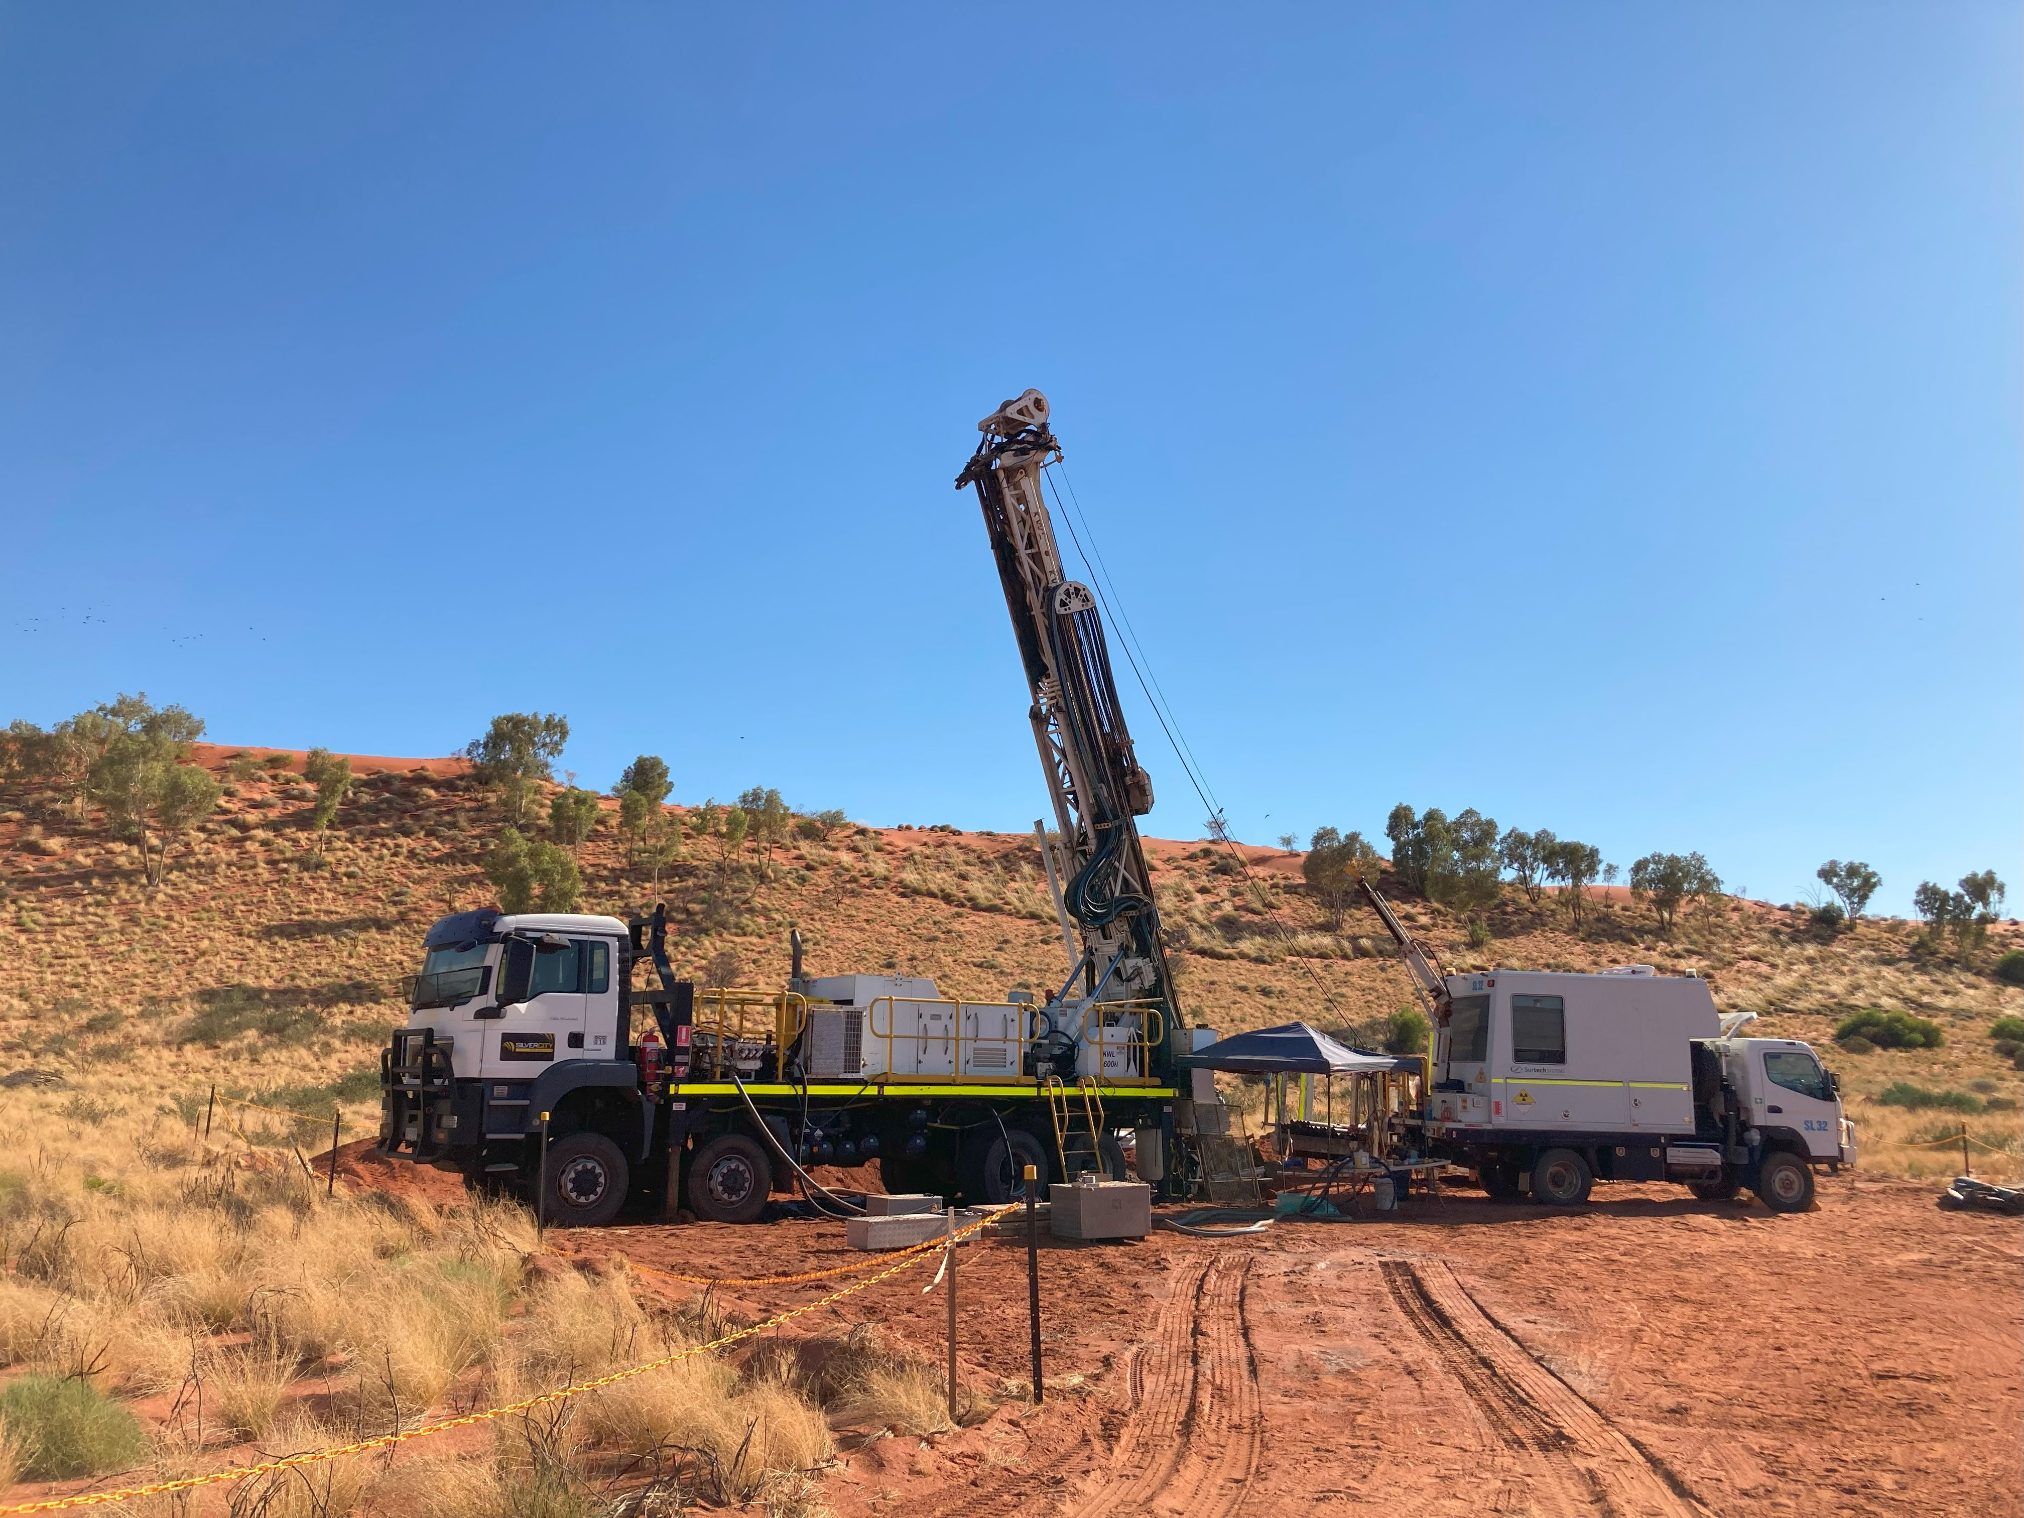
background
Geophysical data plays a crucial role in the mining industry for various reasons.
It aids in target identification, exploration efficiency, resource assessment, environmental considerations, mine planning and monitoring, and cost reduction.
It also significantly contributes to informed decision-making, maximising the chances of success of operations while minimising risks and environmental impacts.
To obtain and acquire the data, personnel must use electronic tools that provide information from drilled holes.

Slide 3
PROBLEM
Geophysical information can be gathered with logging tools run in drilled holes.
General idea
The stability of the drilled holes can degrade over time, and it is imperative to know whether the acquired data is accurate for further analysis and to make correct decisions.
Field situation
May be inexperienced
May acquire information that is not accurate and not realise
When this is identified, the hole might not be accessible anymore
Operators in the field
Provide personnel in the field with aid to know whether the data acquired is valid or whether they should contact an expert to evaluate the data or run another survey with a different tool
action plan

Slide 4
Proposed solution
internal information
Gather information from different locations taken with geophysical tools and analyse it. Reach out to a services company to request access to the information
DATA integration
Perform the ETL process to be able to consolidate and visualise relevant data
Priority action plan
Based on the visualisation of the data, create a model to aid personnel gain confidence in the acquired data promptly

Slide 5
Project OVERVIEW

Slide 6
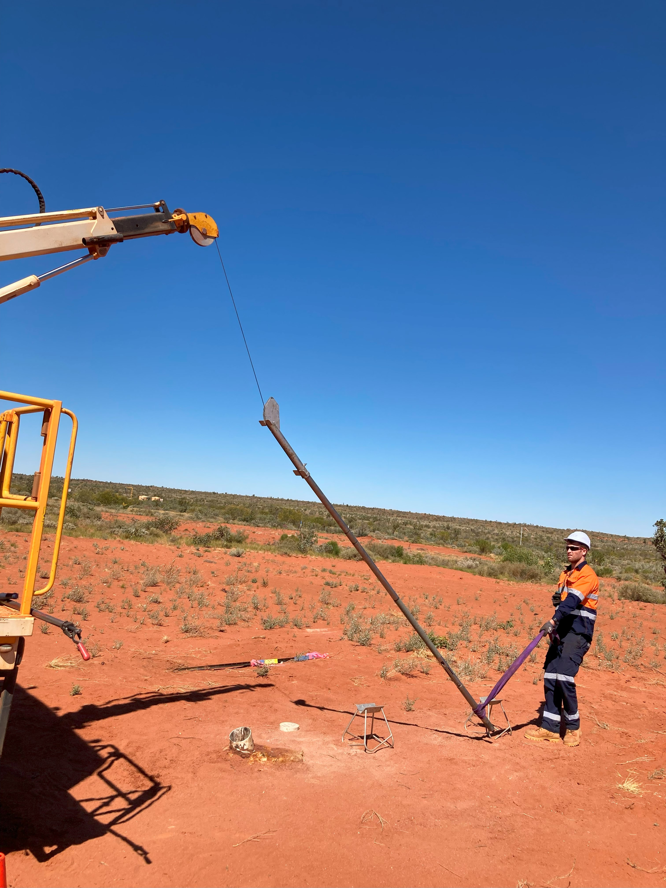
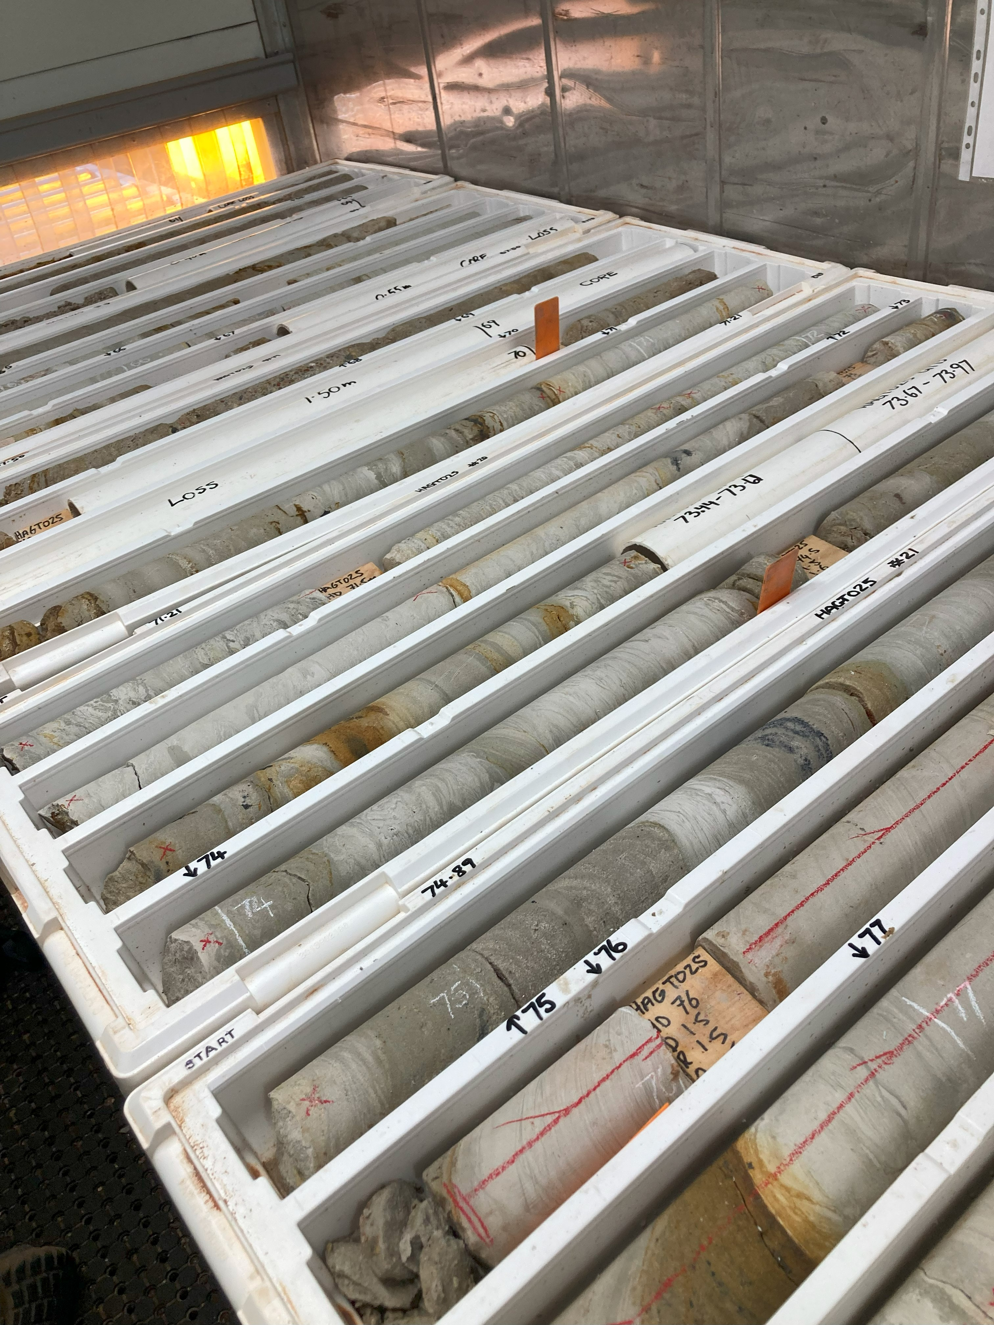
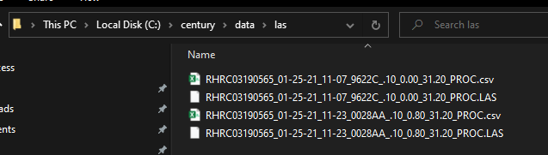
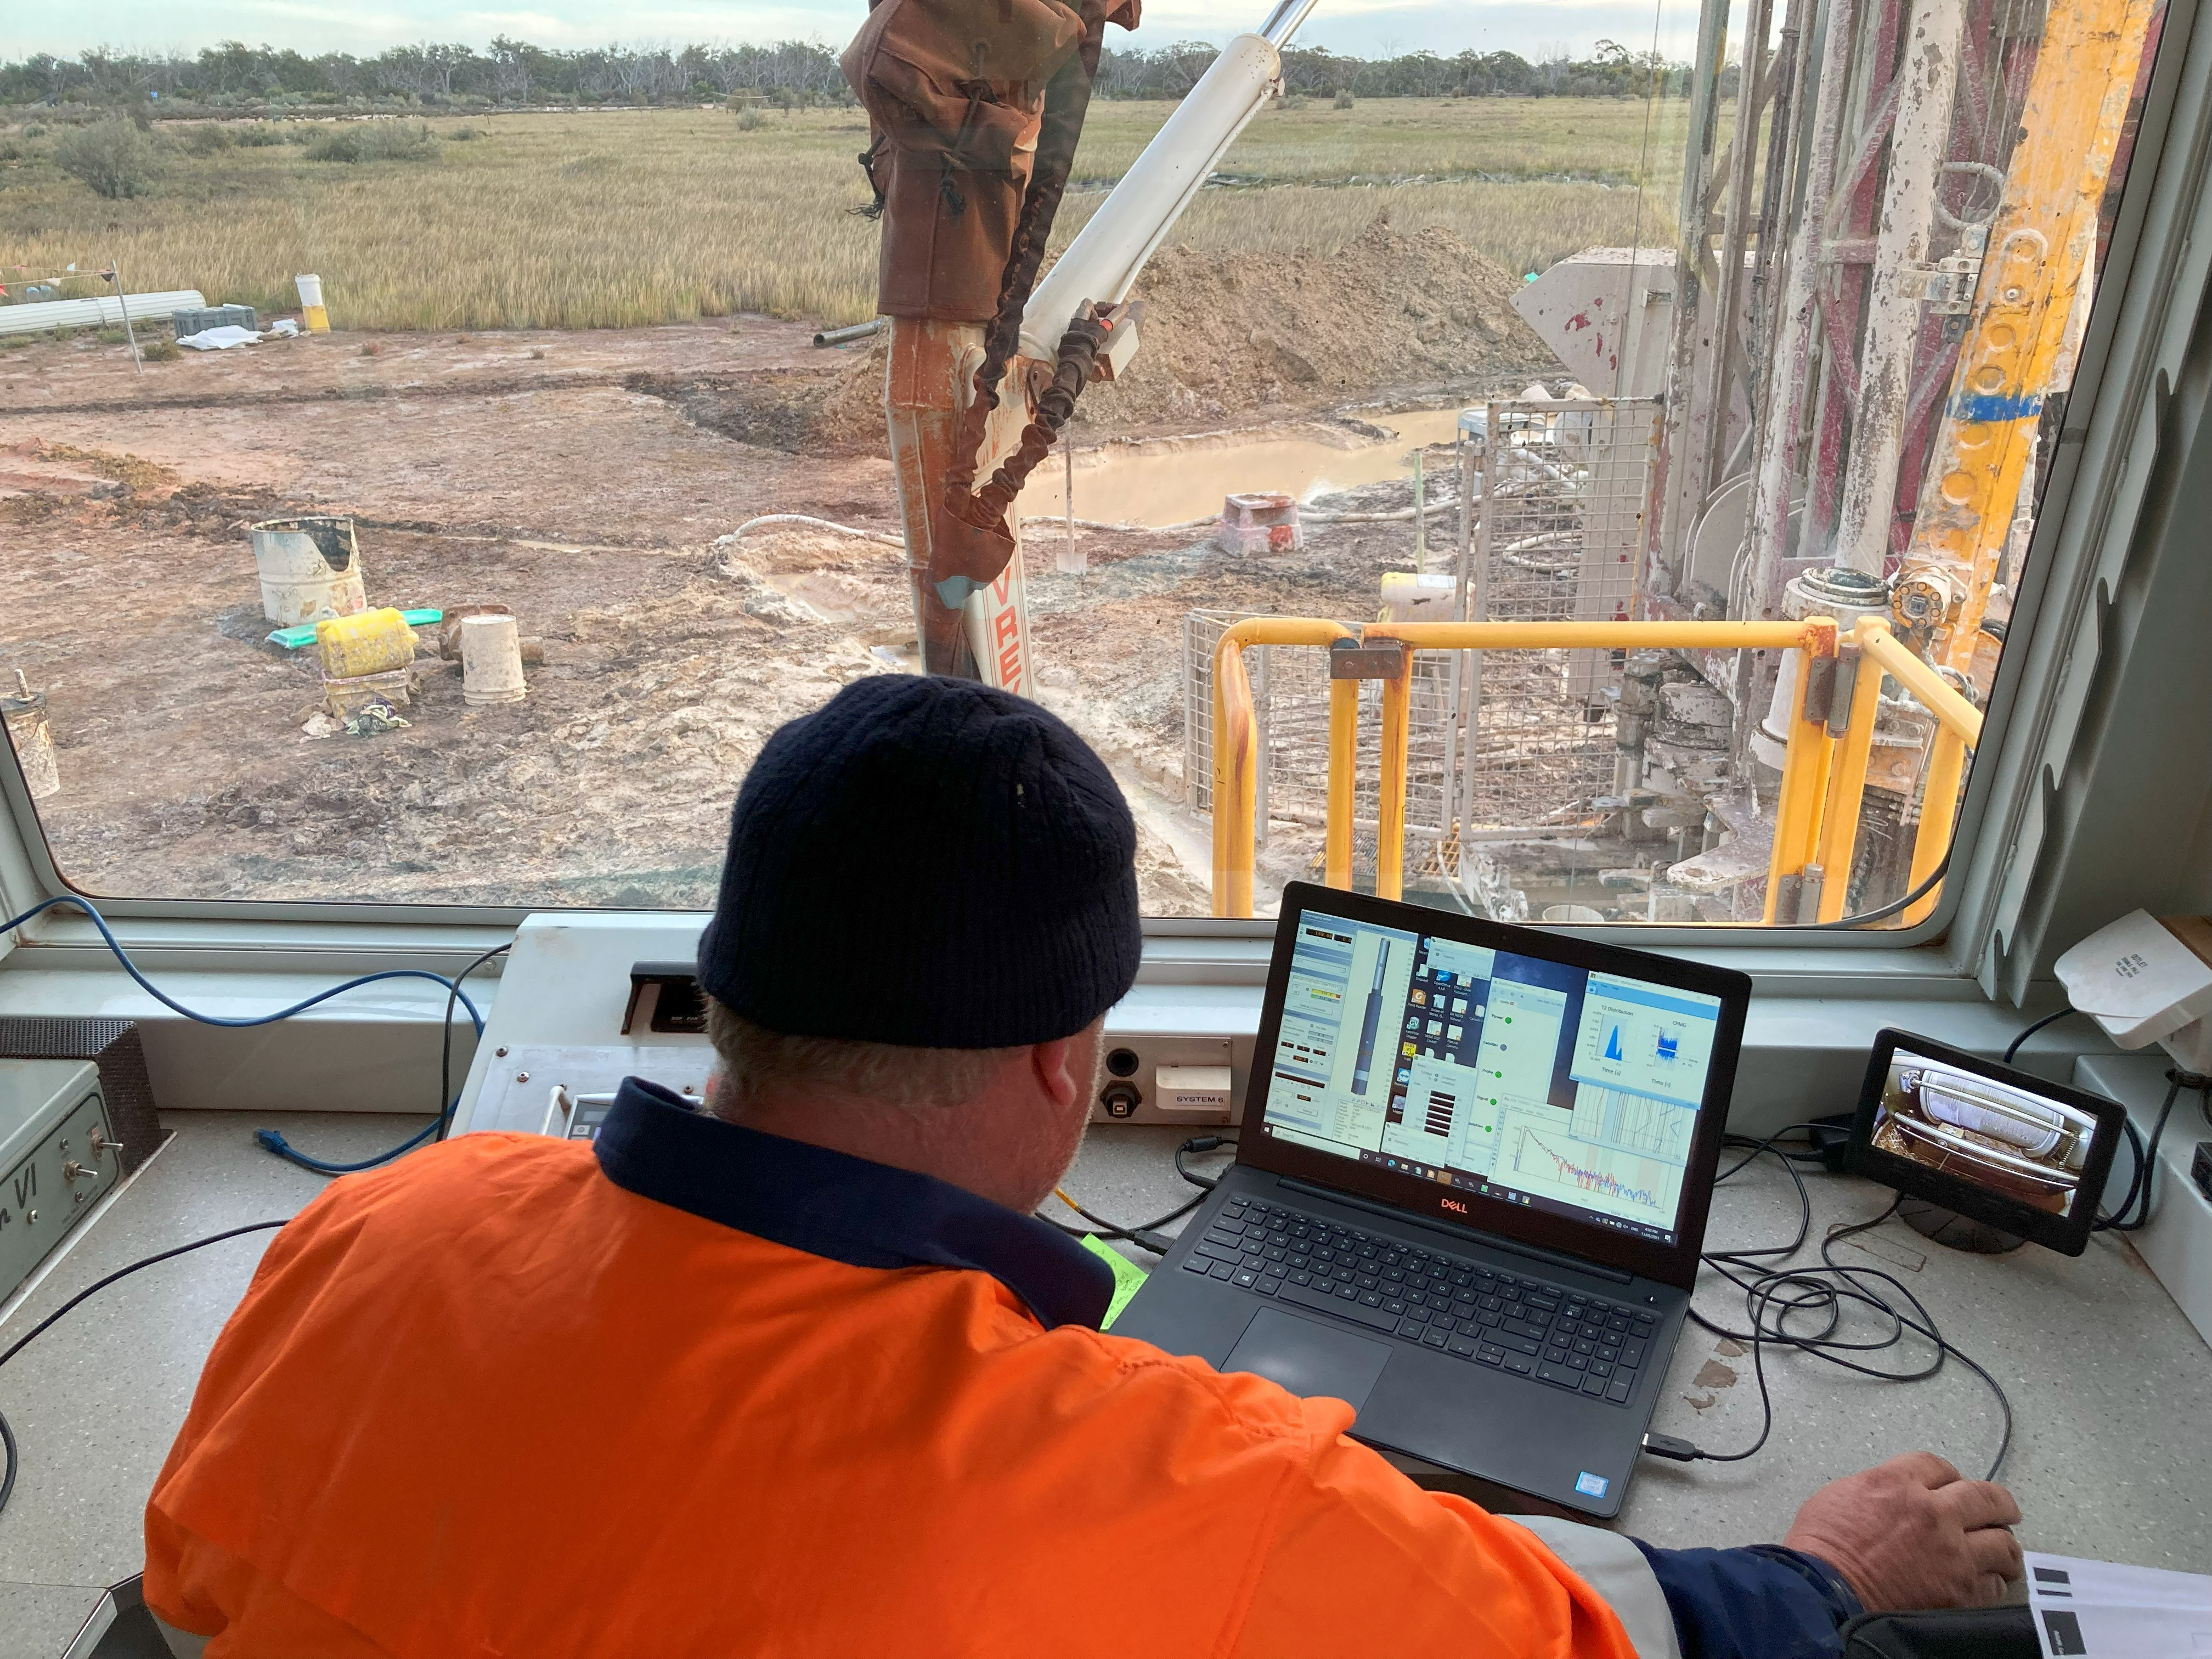
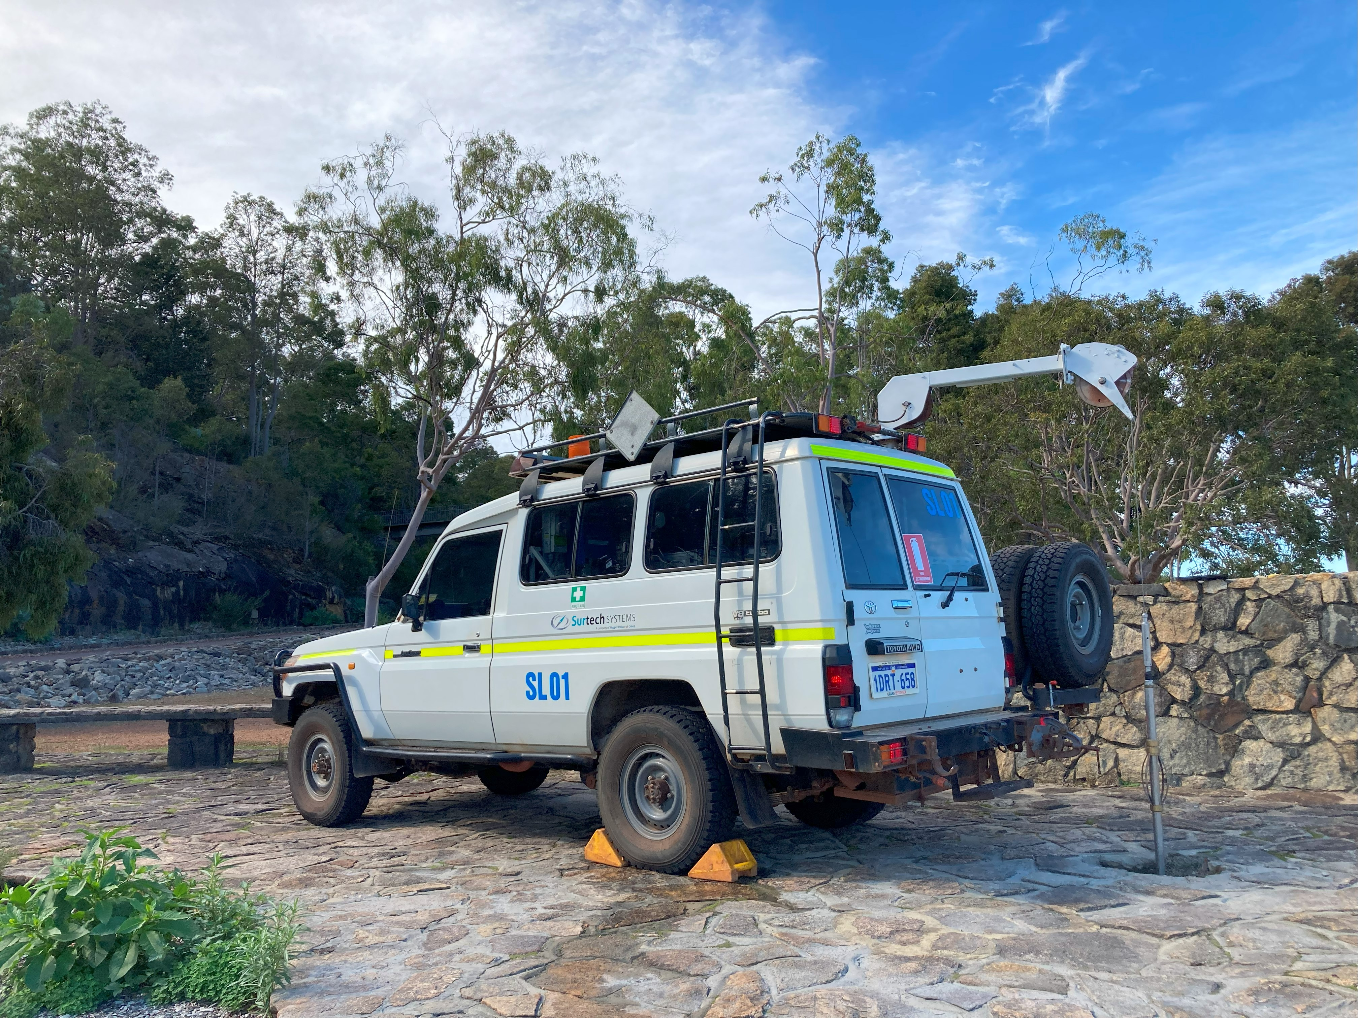
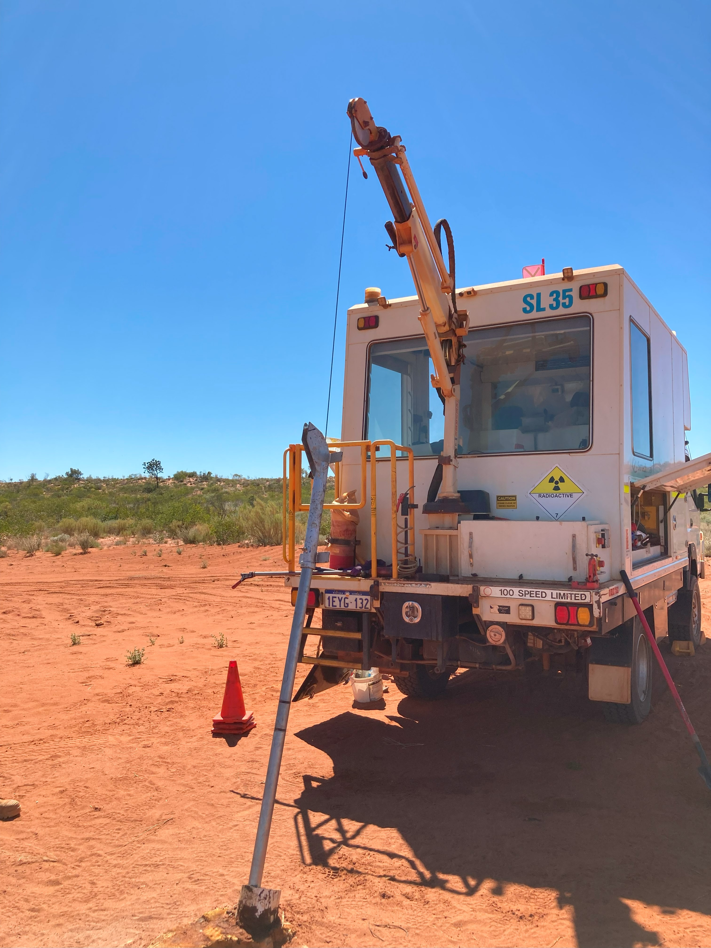
Gathering data

Slide 7
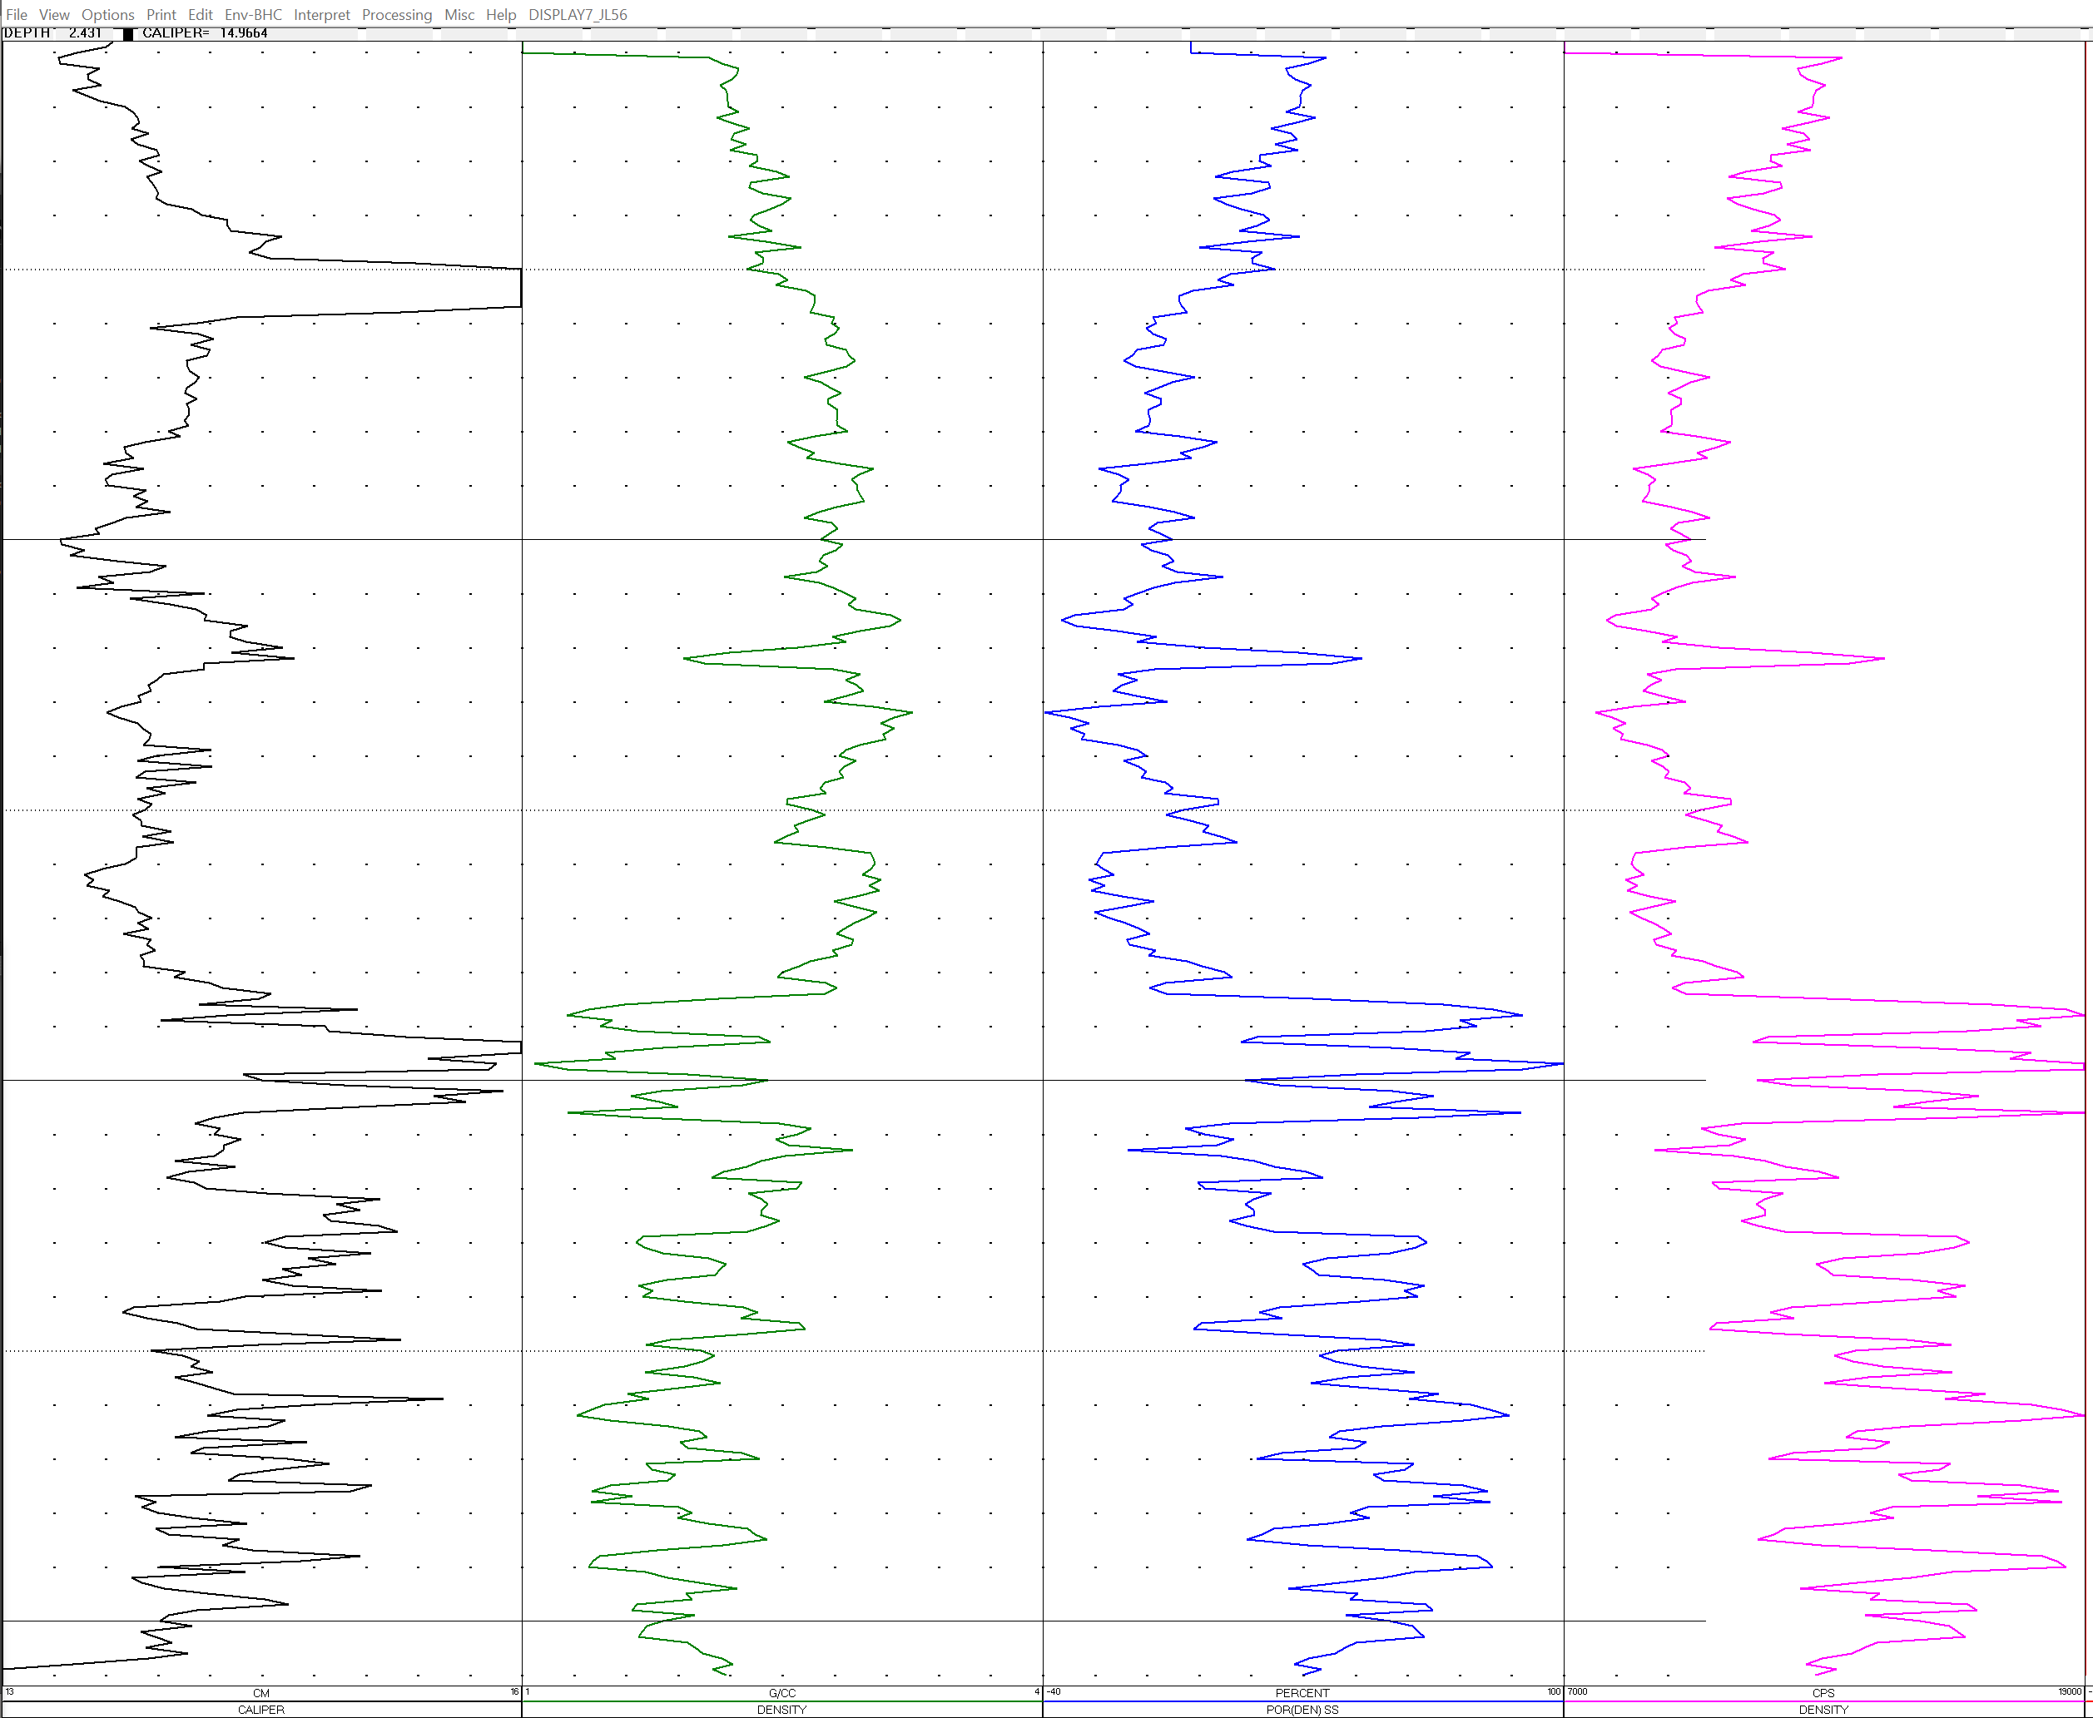





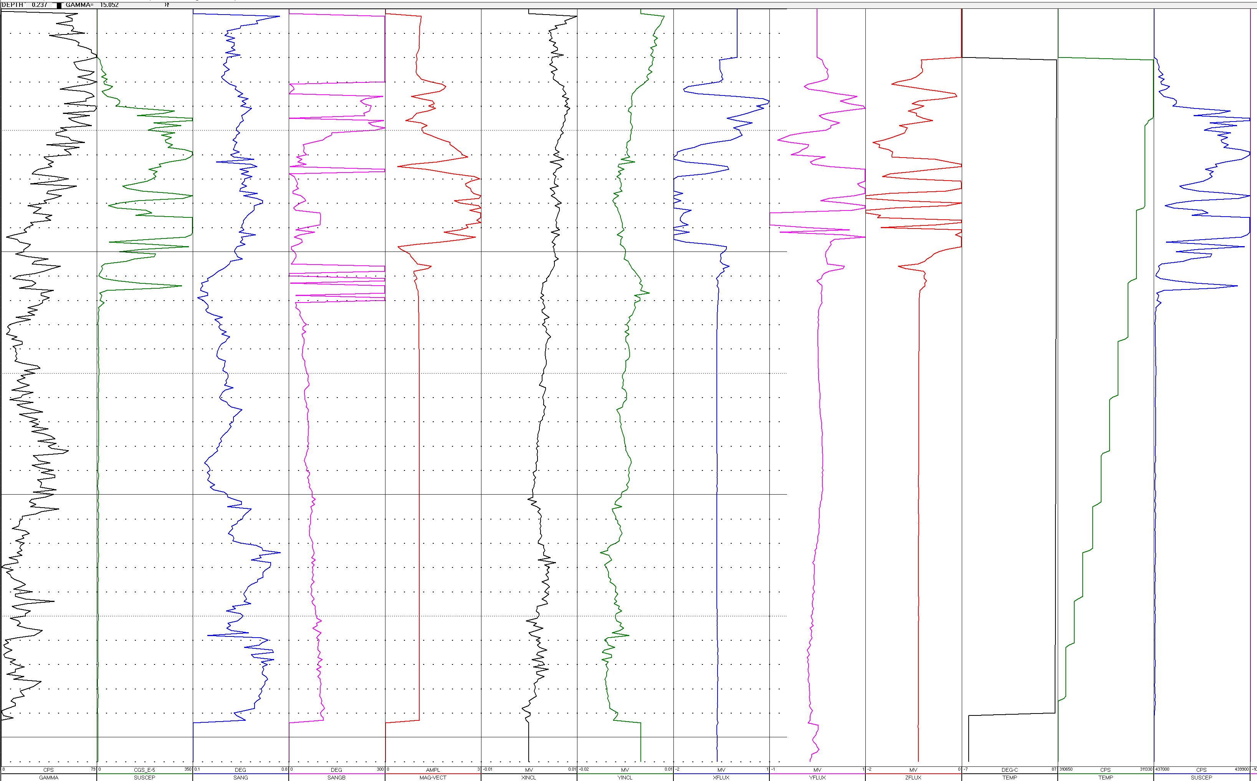




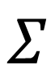
Gathering data
Formation Magnetic Susceptibility and Density measurements from almost 7000 holes were used.
Data was consolidated by tool type
Tool channels were analysed to create a model to perform clustering
1
2
$$Σ$$
SQL
3
…
n
CSV

Slide 8
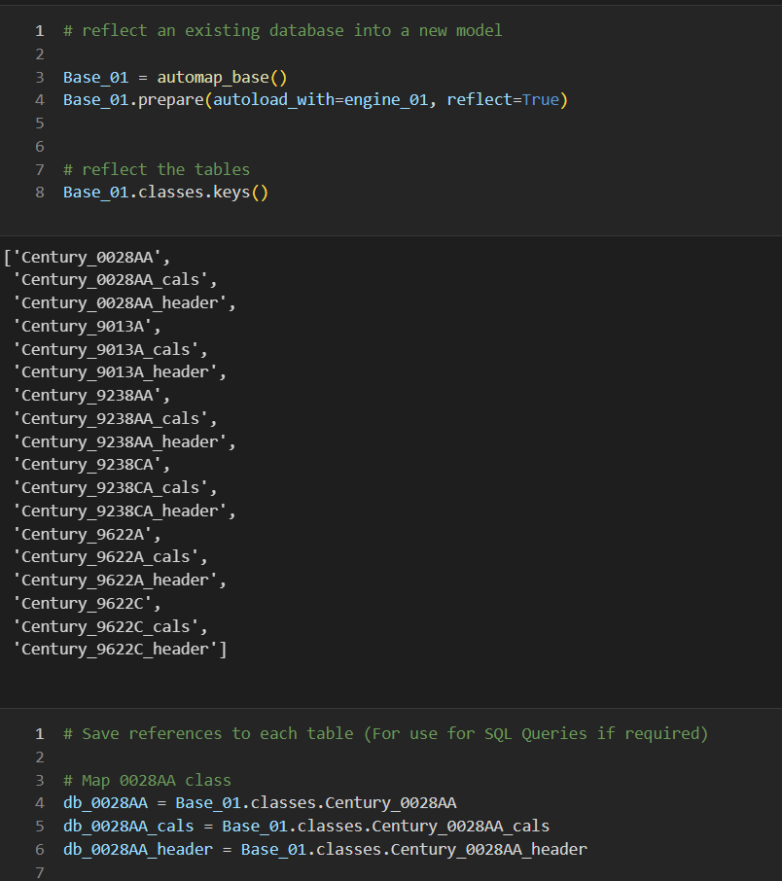
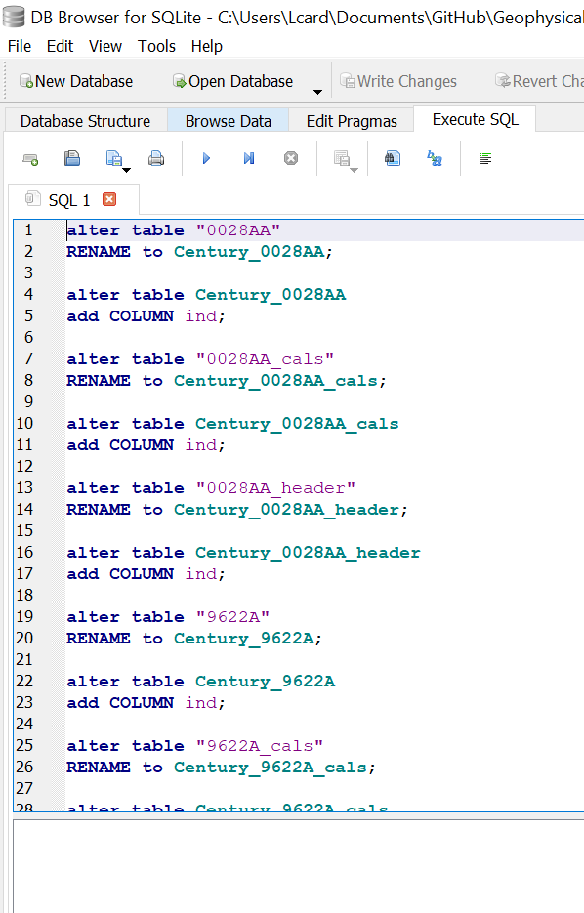
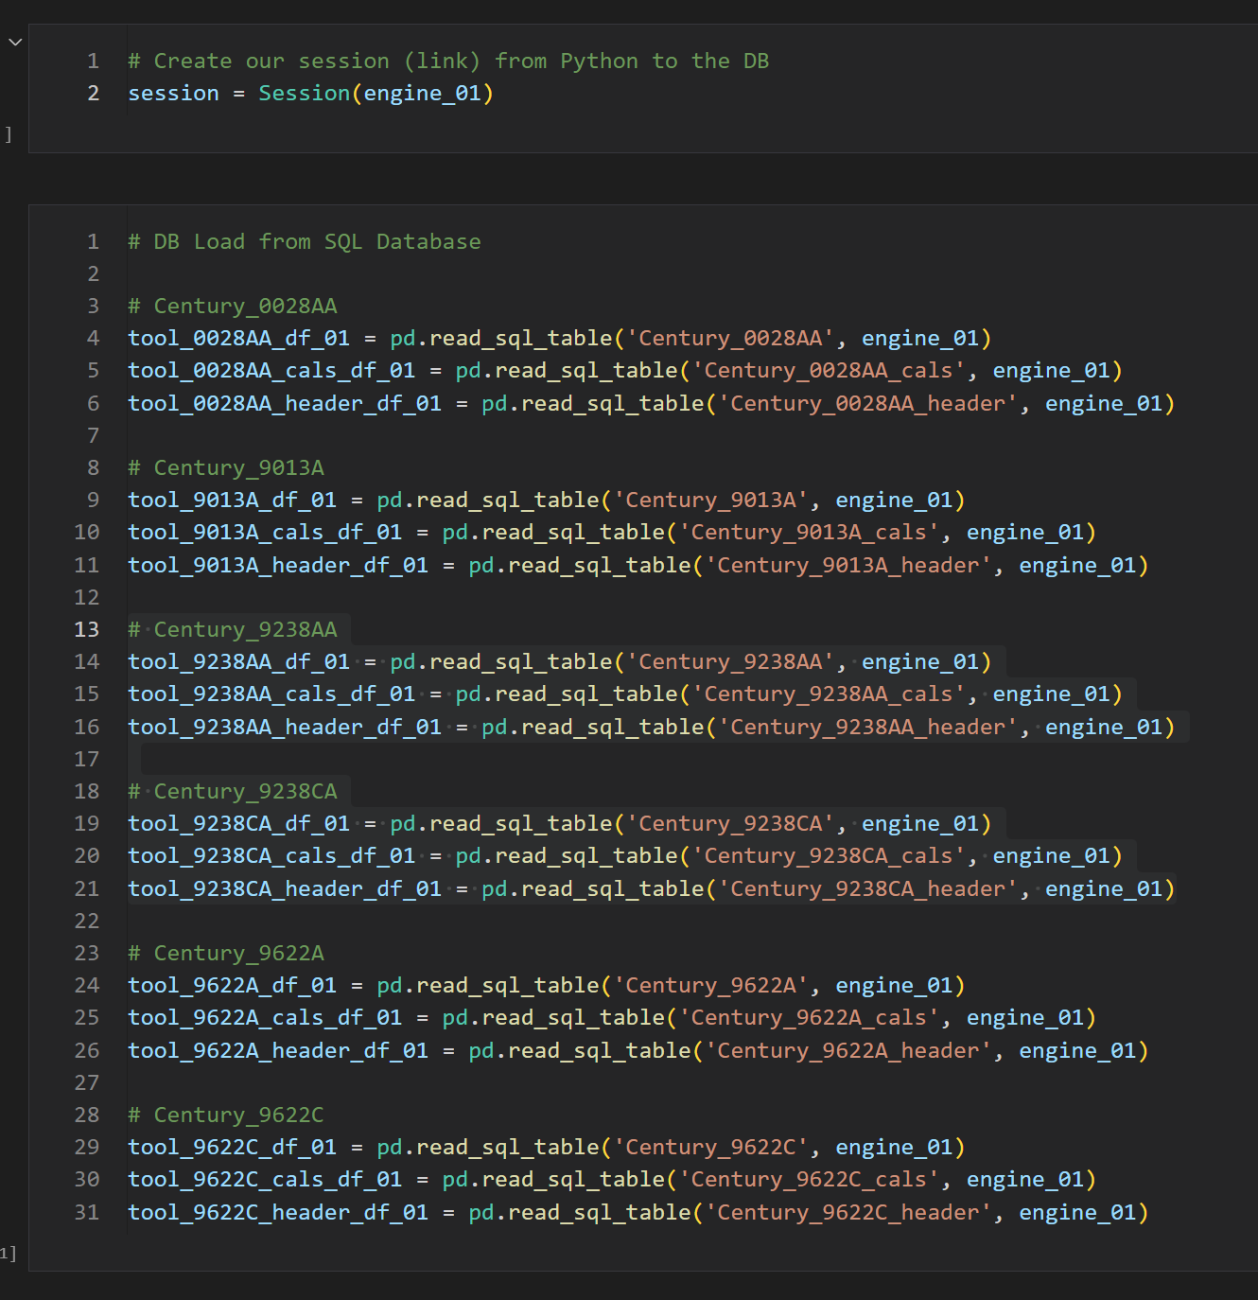
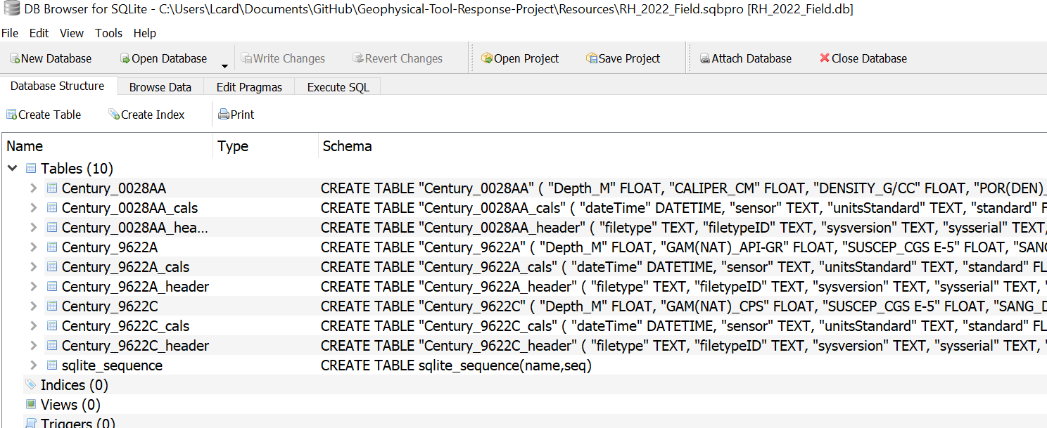
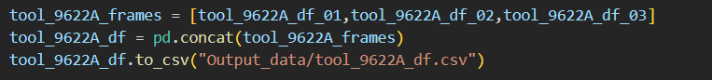
Creation of SQL Lite database and data loading
SQLite Datasets from different Fields altered to be read with SQL Alchemy
Auto-Incrementing Indexes and Primary Keys created
Concatenated and consolidated information in CSV files

Slide 9
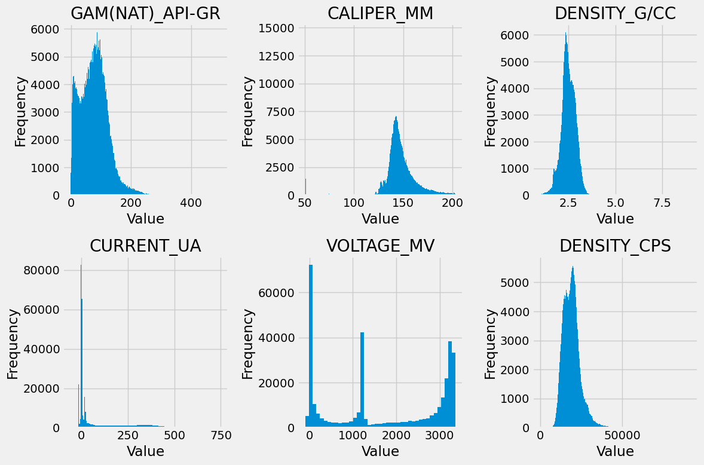
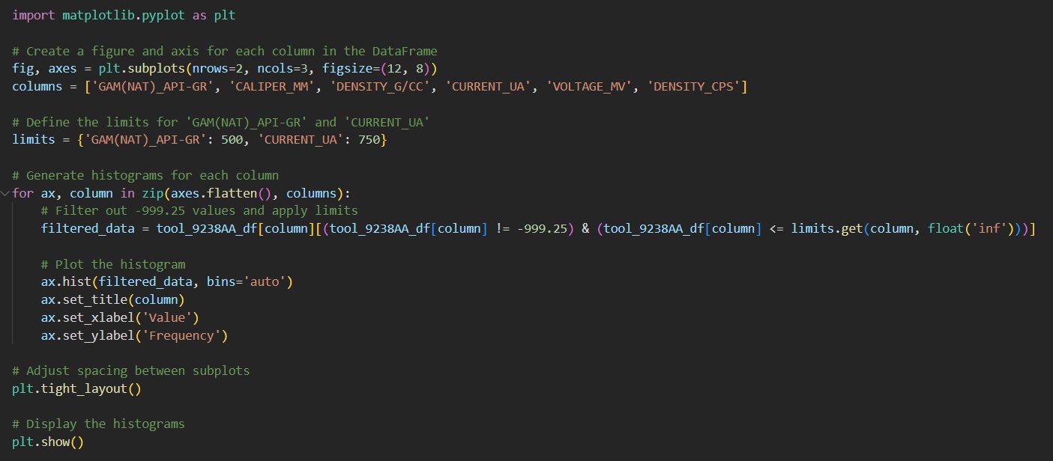
Analysing data
Channels used for modelling:
Magsus Tool - 'SUSCEP_CGS E-5’
Magsus Tool- 'GAM(NAT)_CPS’
Density Tool- 'DENSITY_G/CC’
Data visualisation required to understand tool response and to determine a model to be used
To help the operators we need to understand the data first!
Notes:
https://math.stackexchange.com/questions/4045242/averaging-over-mahalanobis-distance-vectors-of-different-clusters
https://towardsdatascience.com/machine-learning-for-anomaly-detection-elliptic-envelope-2c90528df0a6

Slide 10
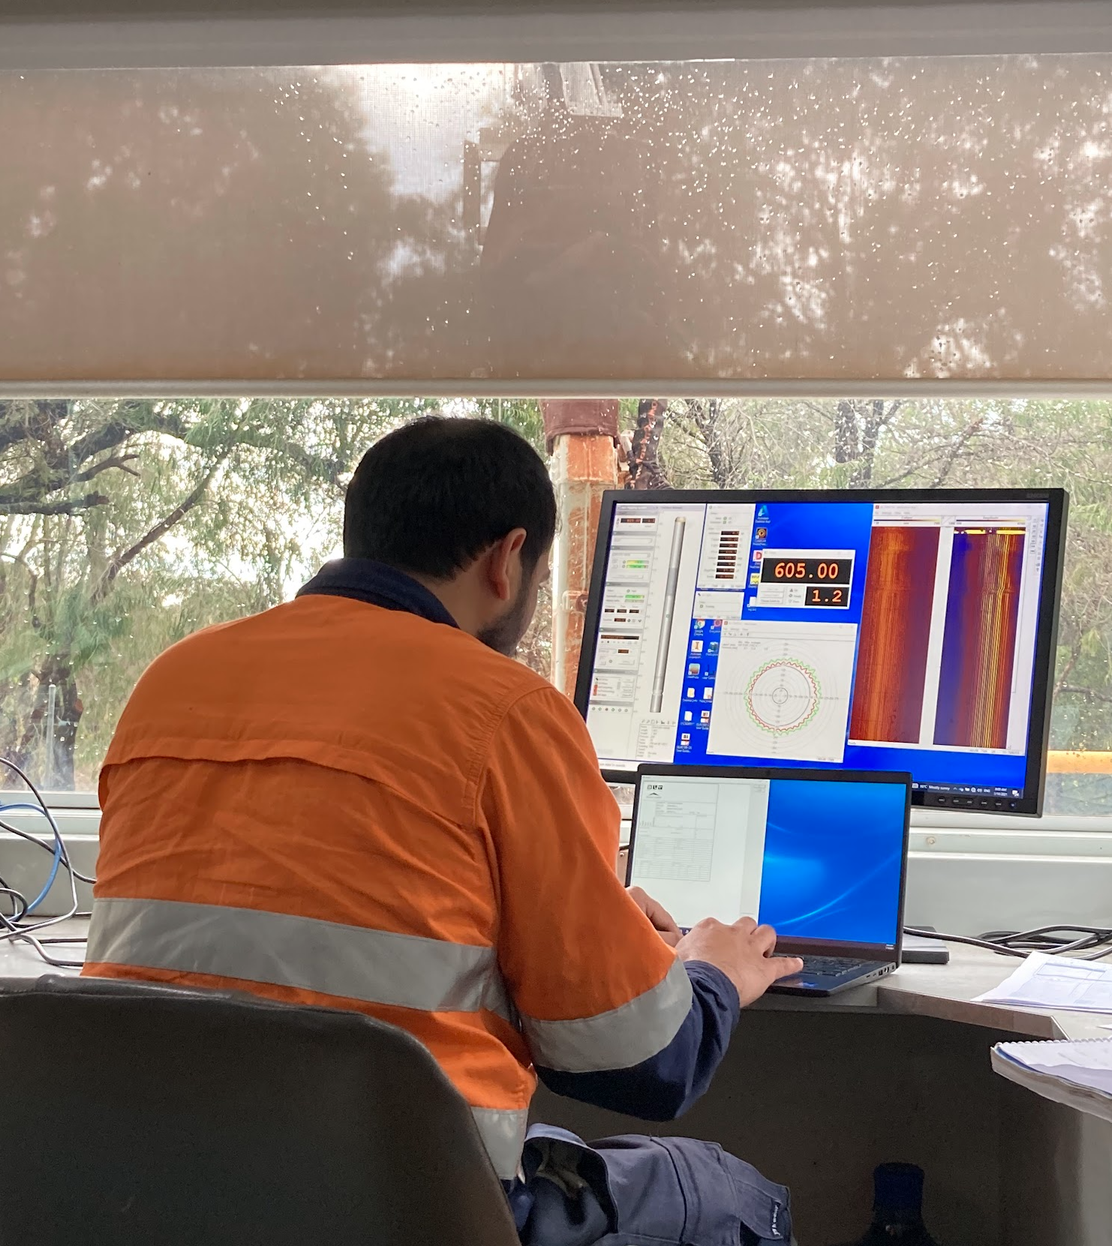
Data analysis /First operator aid
Operators run tools
Lines coming up: Good or bad?
Notes:
In one location, more than one product line can be present. For this reason a drill down visualization was added to check to see whether there were differences between product lines. This chart also presents the data for the 3 types of compliance.

Slide 11
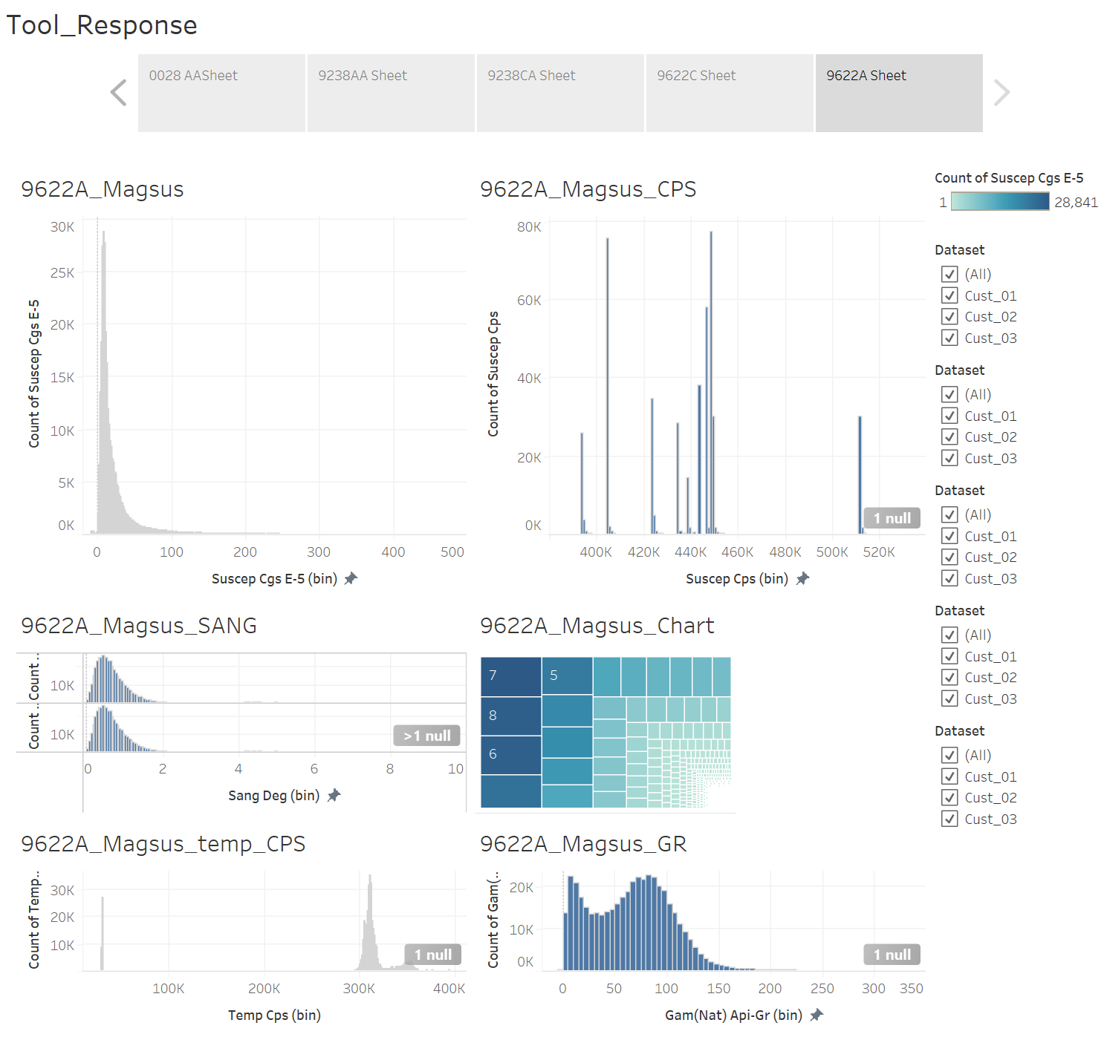
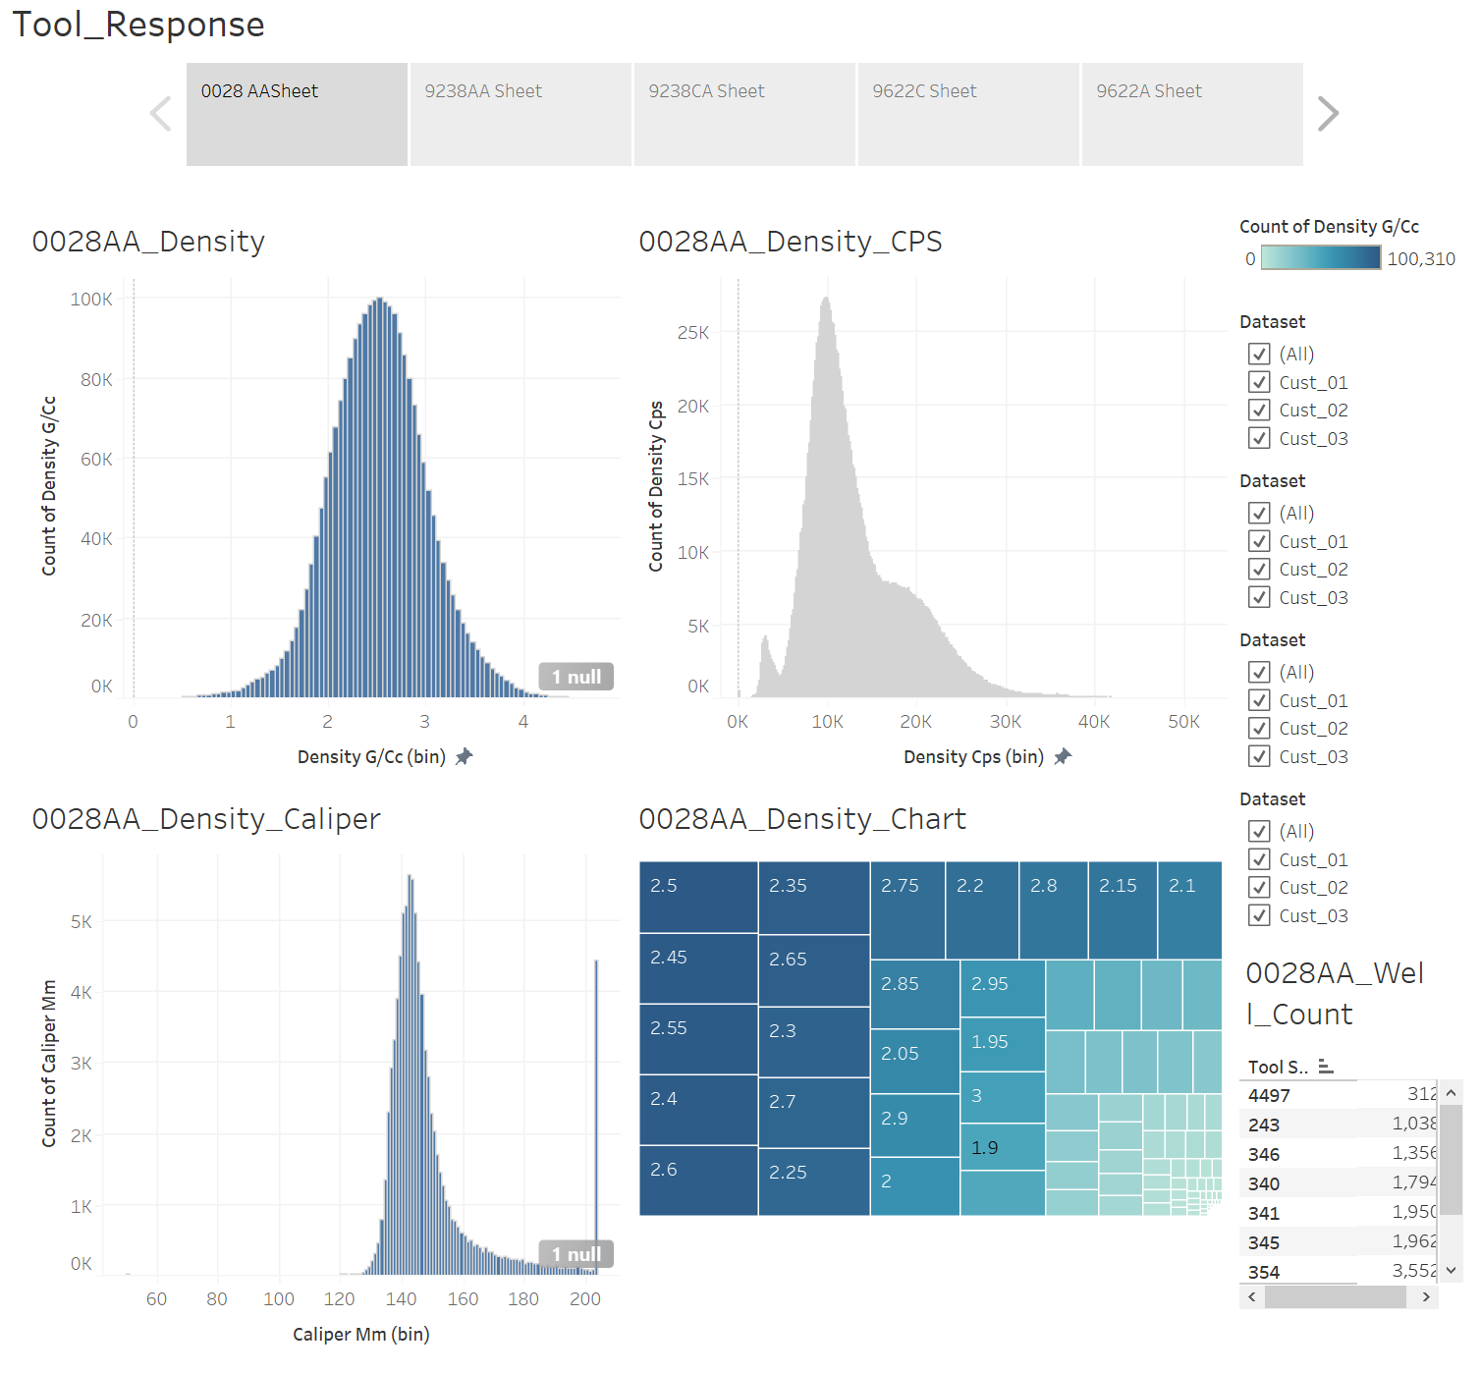
Data analysis /First operator aid
Interactive Tableau dashboard created to guide on expected tool responses
Guide for data cleaning for ML
Notes:
In one location, more than one product line can be present. For this reason a drill down visualization was added to check to see whether there were differences between product lines. This chart also presents the data for the 3 types of compliance.

Slide 12
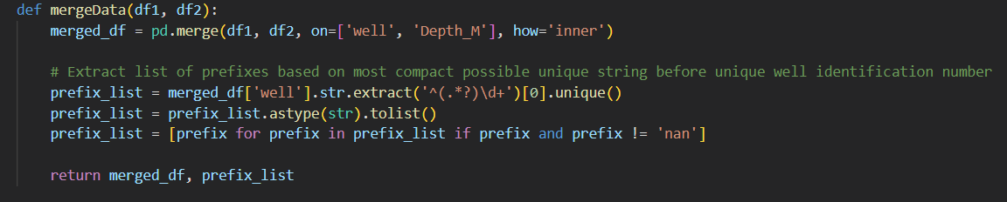
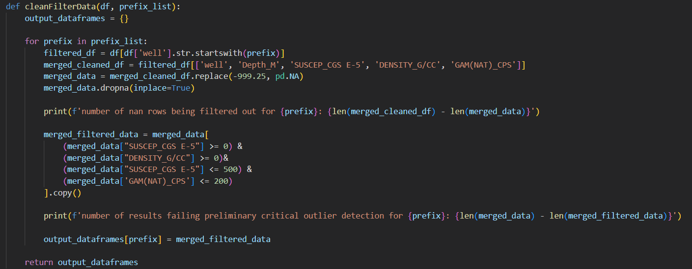
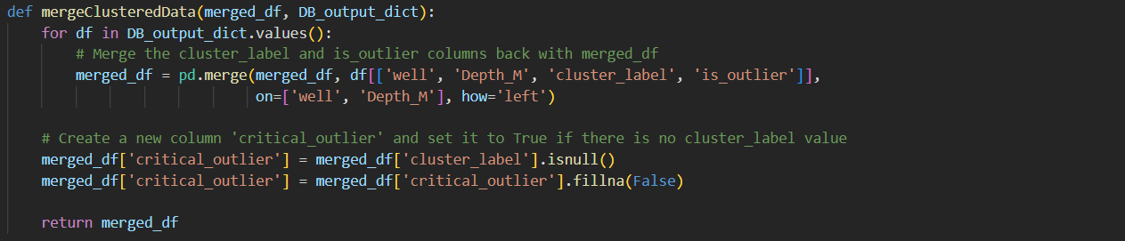
Cleaning DATA
Merged the dataset for Magsus and Density
Hole with matching (‘well’ and ‘Depth_M’)
Removed “999.25” Values
Industry standard for N/A values in tool logging
Removed values that are not feasible
Negative Susceptibility or Density values
Values outside the general stats obtained from the analysis of the available data
Notes:
Initially, the data for the three geophysical parameters is split between two different tools, which has been run through the same holes.
The first step is taking the two outputs from the tools and merging them together based on a common well and depth.
Then a list of prefixes are extracted using regex, in order to ensure that we look at each geological area independently from one and other, and a merged df is output.
Once merging is complete, the df goes through a process of cleaning NA values, represented by -999.25. additionally based on tool specifications values that fall far outside of realistic values are removed,
which will then be classified as critical outliers by the mergeClusteredData (suggesting some kind of tool malfunction has occurred). Following the process of clustering and outlier detection.

Slide 13
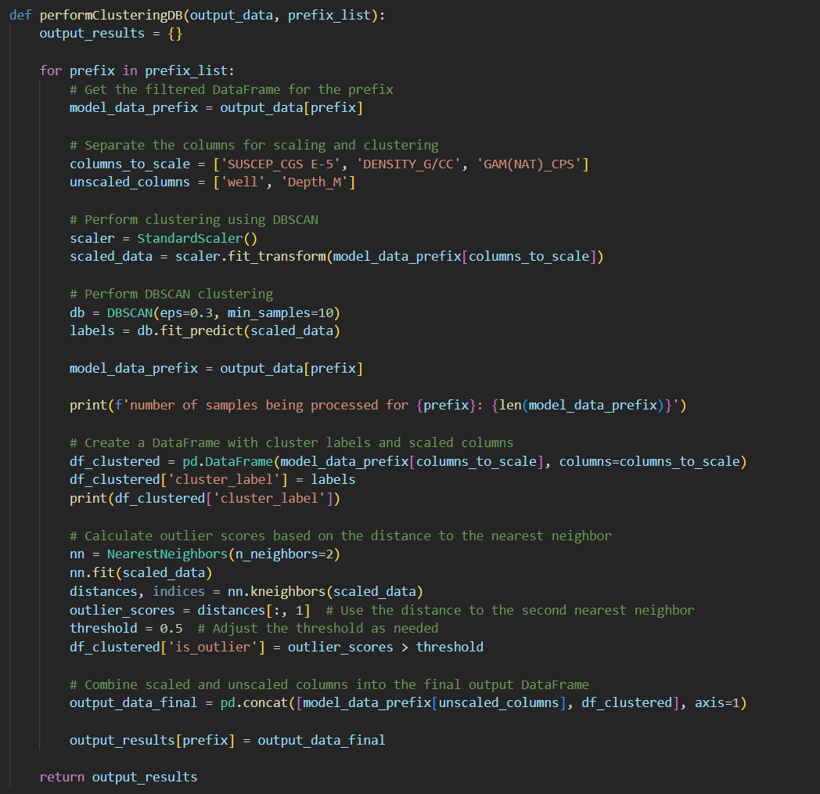
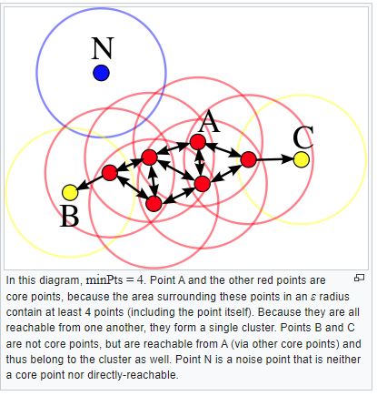
Clustering data – DBSCAN
The DBSCAN algorithm can be abstracted into the following steps:
Find the points in the ε neighborhood of every point, and identify the core points with more than minPts neighbors.
Find the connected components of core points on the neighbor graph, ignoring all non-core points.
Assign each non-core point to a nearby cluster if the cluster is an ε (eps) neighbor, otherwise assign it to noise.
Clustered data by hole prefix (hole geography)
Notes:
https://en.wikipedia.org/wiki/DBSCAN
A couple of different methods of clustering were trialled, however we settled on DBSCAN which seemed to best represent realistic clusters forming in the data. Density-Based Spatial Clustering of Applications with Noise
In this function we feed in the cleaned data which at this point is saved inside a dictionary with the key being the unique prefix, as well as the prefix list obtained earlier.
We then loop through each prefix and perform clustering and outlier detection separately, scaling the 3 geophysical response columns, as well as retaining the well and depth columns so that the outputs can be re-combined with the original data later.
We then scale the susceptibility, density and gamma results and perform the process of using DBSCAN to cluster the data. We played around with the number of min_samples and eps values and settled on 30 and 0.3 respectively.
Eps determins the max discance between two samples for them to be considered in the same neighbourhood and min samples is how many samples are required to form a cluster. Although using this method a large volume of the data tends to be considered “outliers”, however due to the shape and scale of the data we further refined this with a threshold of.5 to restrict the ouglier classification further to what we visually felt was a reasonable number.
Finally, samples that are have an oulier score > than the threshold value are assigned true for a new column is_outlier, and are appended back into the original dictionary, under the prefix being fed into the for loop.

Slide 14
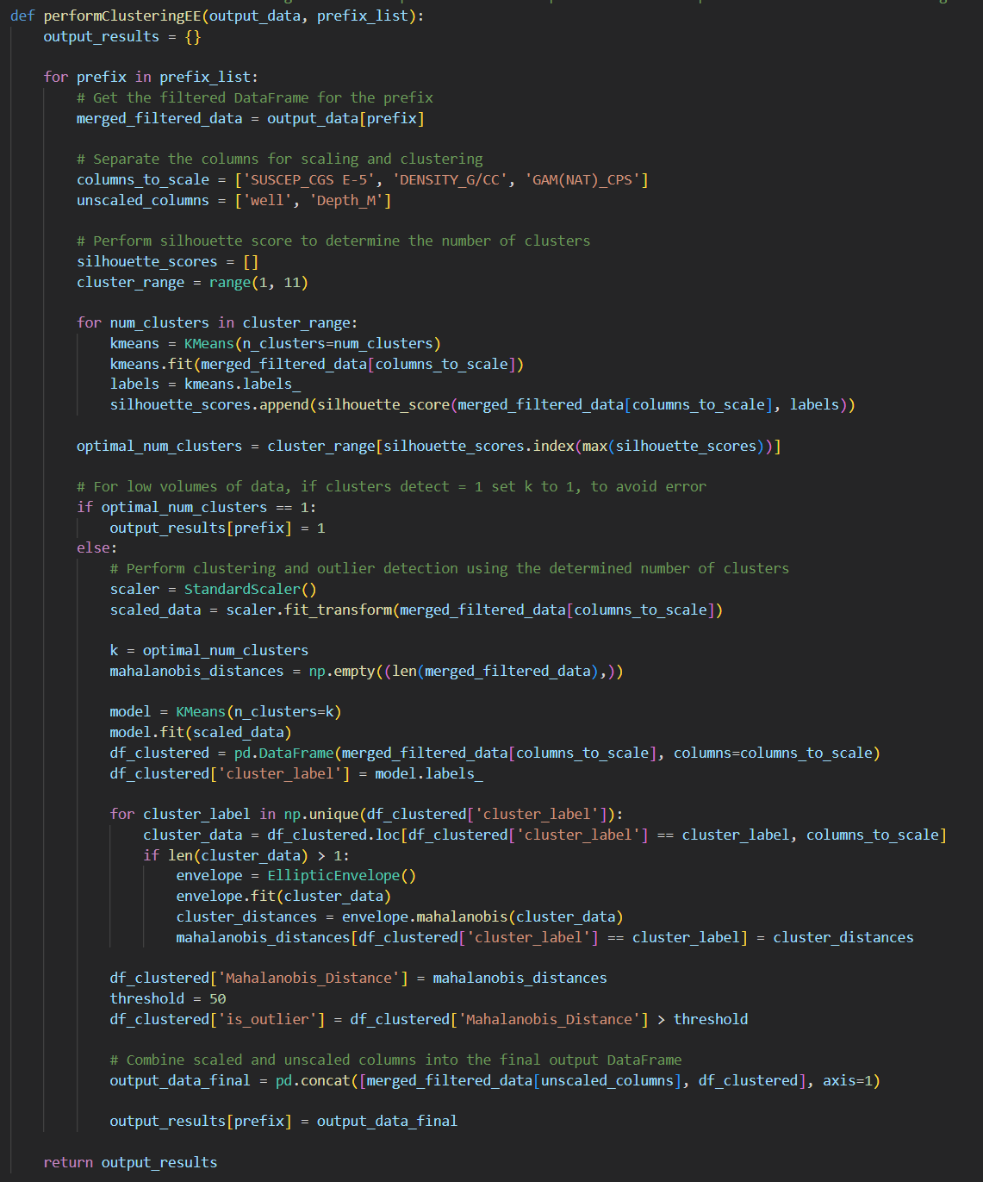
Clustering data
Use of Silhouette scores to predict n of clusters
Elliptic Envelope method was attempted to predict outliers due to expectation of elliptical shaped clusters
This method did not work well, however was left in incase, other areas may have data that behaves elliptically
Notes:
https://math.stackexchange.com/questions/4045242/averaging-over-mahalanobis-distance-vectors-of-different-clusters
https://towardsdatascience.com/machine-learning-for-anomaly-detection-elliptic-envelope-2c90528df0a6
Just for some context, at the beginning of the project based on our experience of the geophysical properties of rocks as you progress through weathered rock at the surface, we initially assumed that the data would form elliptical clusters, as rock units density increases as a function of depth.
For this we attempted to use Elliptic envelope method of clustering, which would work better for that distribution of data. And in order to automate the process of selecting an adequate number of clusters, rather than using more manual methods like the elbow method, we had been using silhouette scoring. When uising this method, the shape of the clusters tended to be quite poor, simply splitting the data in half down the middle, due to the non elliptical nature of the points, and it pulled out far too many outliers, so we chose to peruse another method.
Similarly, not included here we also attempted to use Empirical covariance, however ran into a similar issue, where the shape of the clusters didn’t seem to adequately explain the data and far too many outliers were being predicted, which visually didn’t seem to be the case.

Slide 15
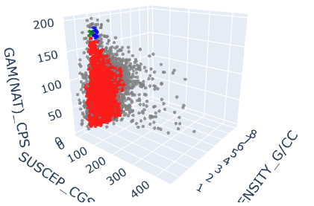
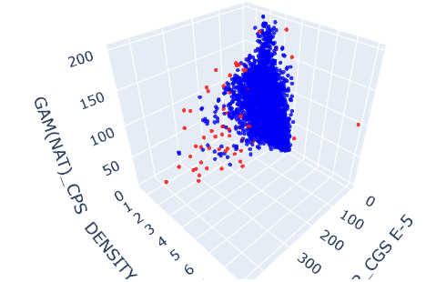
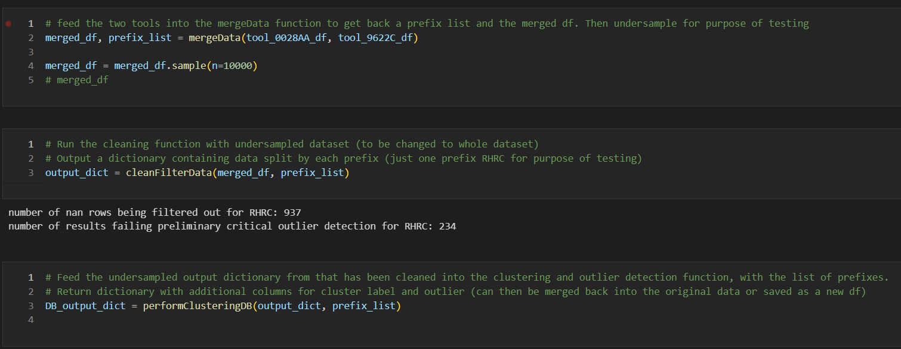
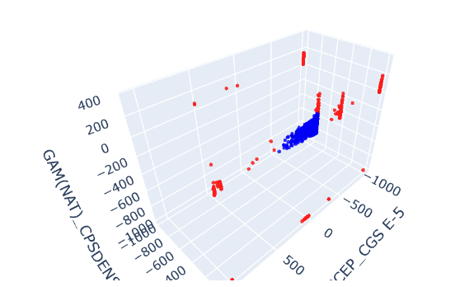
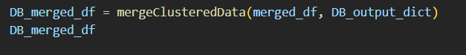
Clustering Results
Other clustering algorithms were used, but the best results were obtained with DBScan.
Notes:
Here are the results of the clustering and outlier detection.
For the sake of my computer we used variations of a downsampled sub-set of the total dataset >2.4million points, but almost always came out with the same number of clusters and outliers.
For the purposes of training the model, we settled on 500k samples. (although in the image its set to 10k which was used for the purpose of creating aesthetic visualisations, as any more and it just looks like a solid mass of points)
On the top left you can see the cluster groups, generally 1 large cluster forms in red, which likely corresponds to the barren host rock sediments that make up a majority of the data, with smaller clusters forming at higher densities and gamma values, corresponding to other unique lithologies.
The grey points in this case are the initial classification of potential “outliers”, however after we use our threshold, you can see on the top right, the data points in red, which are the final output of classified outliers.
Finally at the bottom we included an example of the points which were filtered out in the earlier stages, where I mentiond how points that fell far outside the specifications of the tool were removed and classified as critical outliers. So the bottom image is the same as the top two, where all points in the top chart have been coloured blue, as either good data or potential warnings, and critical outliers are shown in red, as a result of poor tool calibration or technical issues.

Slide 16
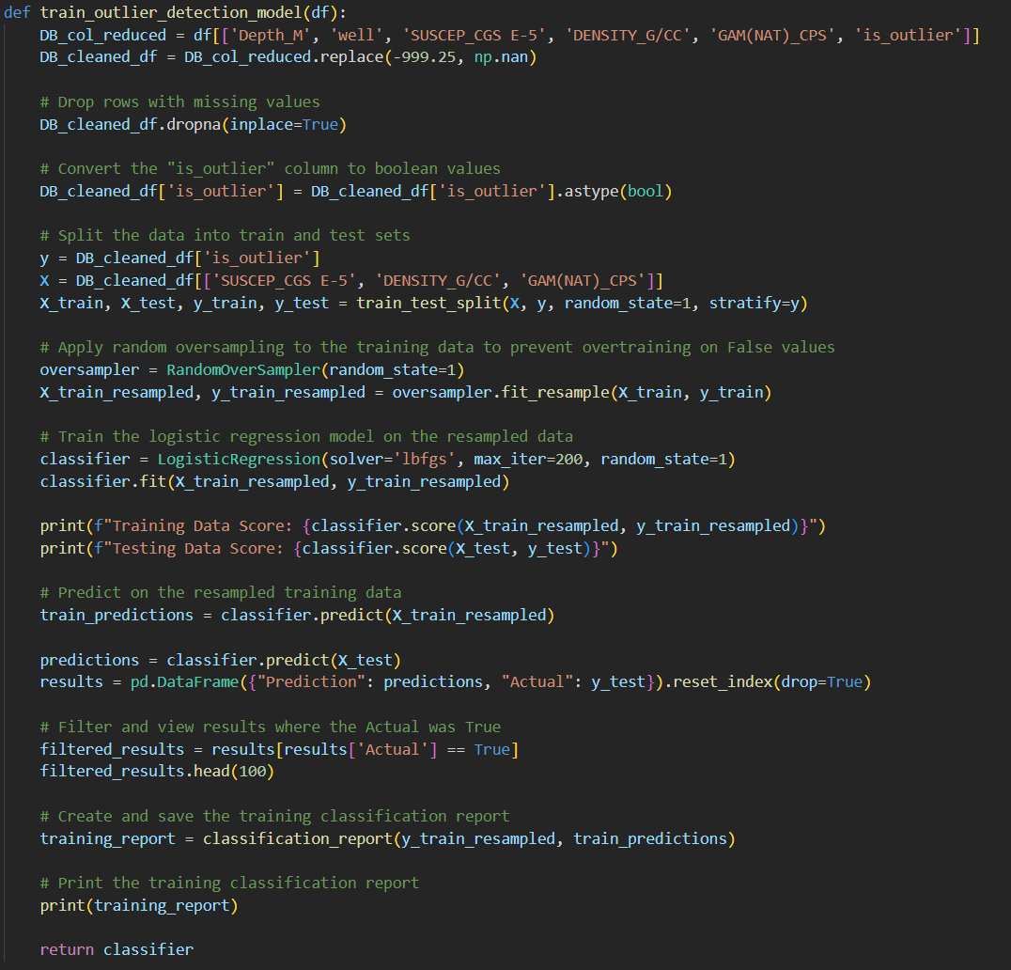
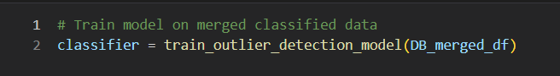
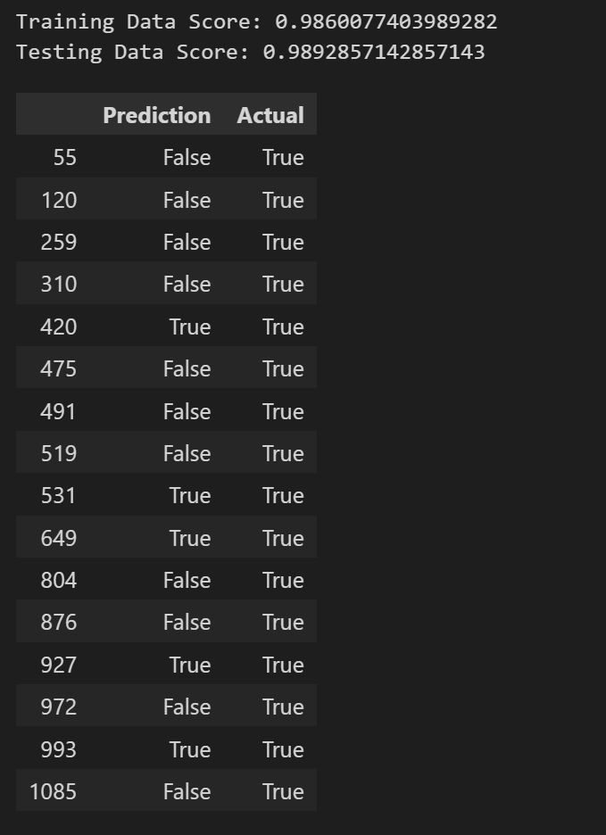
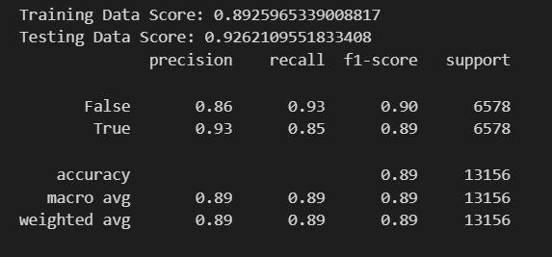
Machine learning REsults
Supervised model was trained using the now classified original dataset
Consistently obtaining an accuracy of 88-93% depending on the data used to train the model
The model was then returned from the function for quick classification of outliers in real time in the field
Notes:
Once we had classified outliers and re-appended them to the original dataframe, we used these results to train a supervised model using Logistic regression.
Here we re-introduced the original dataset and reduced it down to only the columns required for training and re-merging.
The dataset was split into training and test data, and due to the low number of outliers relative to the total dataset, in order to prevent overtraining, we used the random oversampler to ensure it was being fed the same number of outliers and non-outliers.
Once the training was completed we printed the results using a classification report, and obtained an accuracy of 89%, with fairly decent recall and precision for both outliers and non-outliers, although it fluctuated by a couple of percent.
The classifier was then returned from the function so that the model can be used to quickly predict outliers in holes for operators in the field.

Slide 17
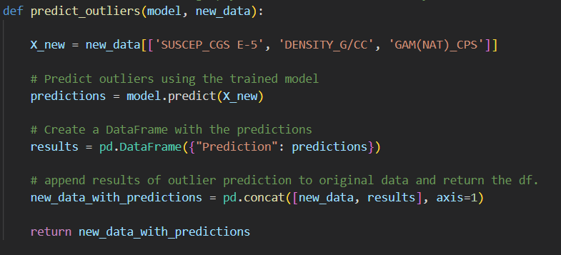
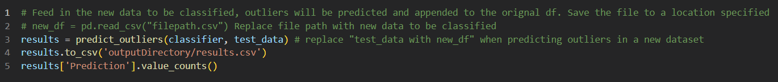
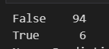
Machine learning Results
Another function is used to take in the classifier and a new dataset (1 hole or a days worth of data) and quickly predict outliers, based on the prefix/area the operator is working in
This was simulated using a different subset of the original dataset of 100 random samples
Operators can then make calls in the field depending on the number of outliers predicted relative to the total number of data points
Notes:
Finally, the only function that will need to be used regularly will take in the classifier that has been trained on the dataset with the appropriate prefix, and the new data which could be from a single hole, or at the end of the day when they upload the data.
We simulated this by selecting another random sample of 100 datapoints from the original dataset (most of which if not all that the model wasn’t trained on), and the final results were coming back at around 5% of data being classified as an outlier (warning).
It will be at the discretion of an operator to determine what the appropriate threshold should be for % of outliers in the data, as they should only be taken as a warning and not necessarily that the data is bad. As some times outliers can be a good thing too!
The appended results are returned to the original data input and exported as a csv for ease of use, however this can be changed to an output destination of their choice.

Slide 18
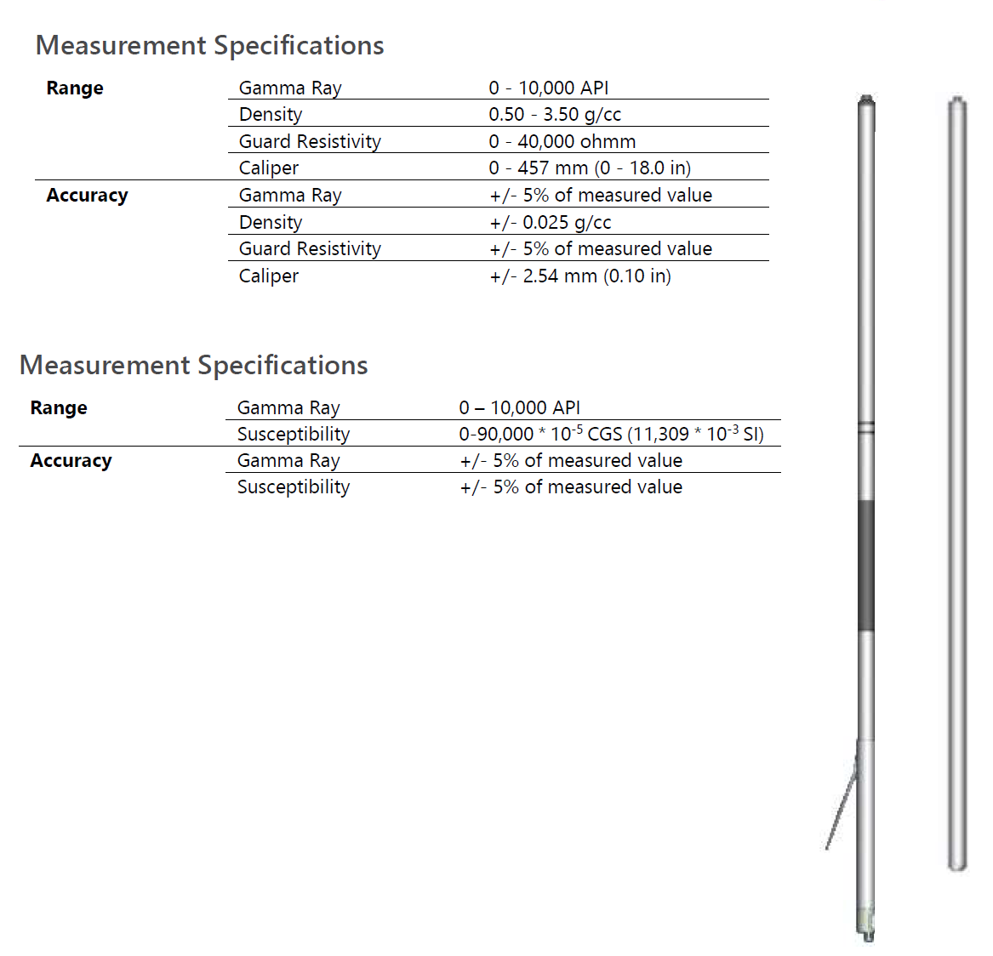
Deciding criteria
Information to decide
Percentage of outliers per hole as compared to the model < 5% OK
Tool outside spec – Not OK
Hardware Fault – No Curve change – Not OK
Percentage of outliers > 5% up to 15% - Be cautious for next hole
Percentage of outliers > 15 % Warning: Call town
Notes:
For the 3 types compliance, equipment was registered as Compliant, Action needed (where the time to expire is within a month), Critical ( within a week) or Non compliant. One of the visualizations plotted the compliance by location.

Slide 19
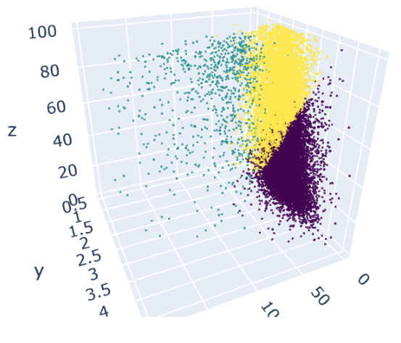
Final remarks
Tools to help an operator that is not experienced were developed including an Interactive Visualization for the tools with Real Data that can show the user how variables interact
A Clustering algorithm was successfully created merging geophysical variables Gamma Ray, Magsus and Density
Visuals from the clustering give a powerful explanation of what is happening based on real data
A logistic regression model was developed, which can provide the user confidence on the acquired data

Slide 20
SUMMARY
A problem worth solving, analyzing, or visualizing was found
Machine learning with the technologies we’ve learned was used to solve the problem
Scikit-learn and/or another machine learning library was used.
Python Pandas, Tableau and SQL were used among others

Slide 21

Project requirements
Based on Project Requirements
Key objective* Metrics
 | Data Model | GitHub | Presentation
A Python script initialises, trains, and evaluates a mode
SQLite Database
The data handled prior to modelling
The model predictive power at least 75%
Model outputs to CSV File
Performance displayed
Files and Readme available
User Driven interactions
Presentation
* Other metrics are subjective – Digestible, easy to interpret, and presentation aspects

Slide 22
THANK YOU
Luis E. Cardenas​
LCardSVR@gmail.com
https://github.com/LCardSVR
Joshua Bell
Josh.Marc.Bell@hotmail.com
https://github.com/JoshMBell

